Slide 1

LoRaWAN Tracking System
Darryl Bilongo, Louis Boucquet, Melvin Campos Casares, Constantin Mirica April 26th, 2019
Group 7
Wild animals tracking - An IoT Solution

Slide 2
Plan
Introduction
?
Web dashboard
Technical part
Conclusion

Slide 3
Introduction
A solution to help the Faune & Biotopes Association to:
Manage their tracking of wild animals using IoT devices,
Help wildlife and habitats in a multifunctional and integrated perspective,
Have a better knowledge of the faune and its habitats,
Have a good management of the faune and its habitats,
Have a better approach for the conservation of the nature.

Slide 4
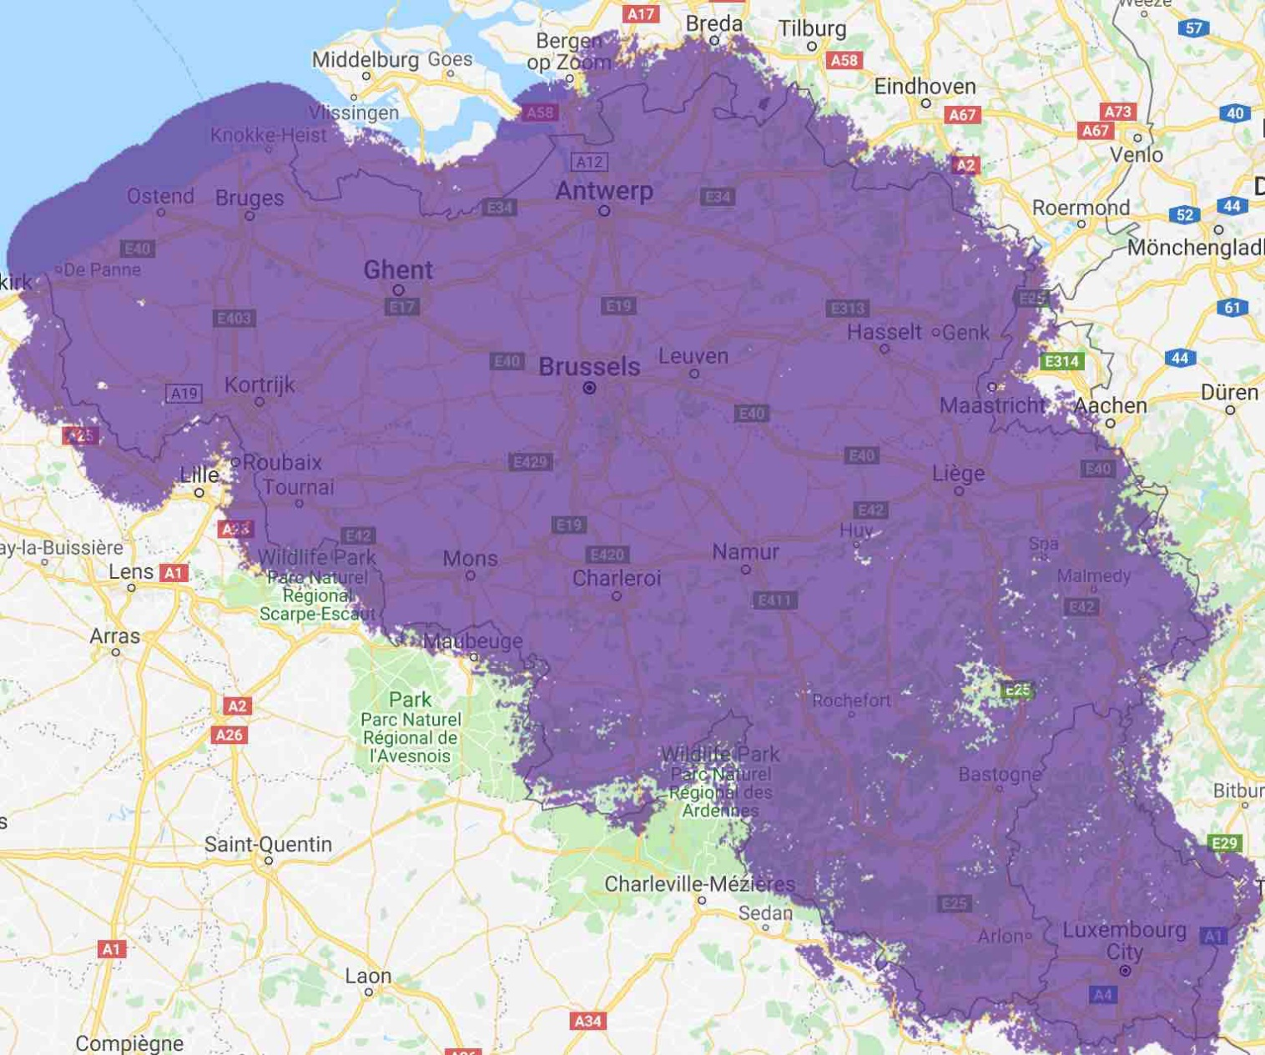
?
Ideal for long range and low power IoT networks
has nearly a complete outdoor network coverage

Slide 5
Web dashboard
ephec.herokuapp.com

Slide 6
Technical part
LoRaWAN Rapid Development Kit
Sodaq Mbili card Rev6 (Arduino based)
LoRa network connection chip (developed by Microchip)
Antenna
Battery
Sensors
Grove – GPS
Grove – 3-axis Digital Accelerometer (+/- 1.5g)
Proximus Enco account

Slide 7

Conclusion
Ease of use and works with any LoRa network available worldwide.
Further implementation?
Integration of « Grove – light Sensor v1.2 »
In order to know if the animal is underground and/or if it’s night.
Save an array of GPS coordinates
Send more information about where the animal went,
Better accuracy on the website.
Create a smartphone webapp

Slide 8
Questions ?
Questions ?
Questions ?
Questions ?
Questions ?

